Slide 1

HEART DISEASE DIAGNOSTIC-ANALYSIS

Slide 2

PROJECT DETAIL
Project Title Heart Disease Diagnostic – Analysis
Technology Business Intelligence
Domain Healthcare
Project Difficulty level Advanced
Programming Language Used Python
Tools Used Jupyter Notebook, MS-Excel, MS-Power BI

Slide 3

OBJECTIVE
◆ The goal of this project is to analyse the heart disease
occurrence, based on a combination of features that
describes the heart disease.

Slide 4
PROBLEM STATEMENT
◆ Health is real wealth in the pandemic time we all realized the
brute effects of covid-19 on all irrespective of any status. You
are required to analyse this health and medical data for
better future preparation.
◆ A dataset is formed by taking into consideration some of the
information of 303 individuals.

Slide 5
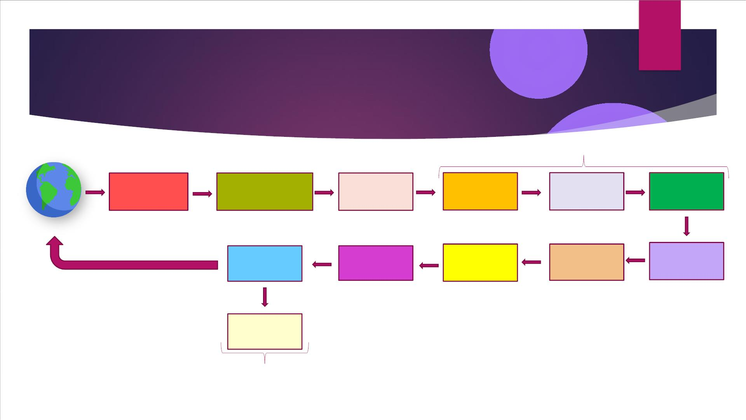
ARCHITECTURE
Data Pre-Processing
Raw Data
Collection
Importing Libraries in
Jupyter Notebook
Load Dataset
Missing Value
Imputations
Handling
Outliers
Data Cleaning
Real World
Power BI
Desktop
Exploratory
Data Analysis
(EDA)
Deployment
Insights
Modelling
Reporting
✓ Low Level Design Document
✓ High Level Design Document
✓ Architecture Document
✓ Wireframe Document
✓ Detailed Project Report

Slide 6
DATASET INFORMATION
age: The person's age in years
exang: Exercise induced angina (1 = yes; 0 =
sex: The person's sex (1 = male, 0 = female)
no)
cp: The chest pain experienced (Value 1: typical angina, Value 2: atypical angina,
oldpeak: ST depression induced by exercise
relative to rest
Value 3: non-anginal pain, Value 4: asymptomatic)
trestbps: The person's resting blood pressure (mm Hg on admission to the hospital)
chol: The person's cholesterol measurement in mg/dl
slope: the slope of the peak exercise ST
segment (Value 1: upsloping, Value 2: flat,
Value 3: down sloping)
fbs: The person's fasting blood sugar (> 120 mg/dl, 1 = true; 0 = false)
ca: The number of major vessels (0-3)
restecg: Resting electrocardiographic measurement (0 = normal, 1 = having ST-T
wave abnormality, 2 = showing probable or definite left ventricular
hypertrophy by Estes' criteria)
thal: A blood disorder called thalassemia (3 =
normal; 6 = fixed defect; 7 =
reversable defect)
thalach: The person's maximum heart rate achieved
num: Heart disease (0 = no, 1 = yes)

Slide 7

Age: Age is the most important risk factor in developing cardiovascular or heart diseases, with approximately a tripling of
risk with each decade of life. Coronary fatty streaks can begin to form in adolescence. It is estimated that 82 percent of
people who die of coronary heart disease are 65 and older. Simultaneously, the risk of stroke doubles every decade after
age 55.
Sex: Men are at greater risk of heart disease than pre-menopausal women. Once past menopause, it has been argued
that a woman's risk is similar to a man’s although more recent data from the WHO and UN disputes this. If a female has
diabetes, she is more likely to develop heart disease than a male with diabetes.
Resting Blood Pressure: Over time, high blood pressure can damage arteries that feed your heart. High blood pressure
that occurs with other conditions, such as obesity, high cholesterol or diabetes, increases your risk even more.
Why These
Parameters
are
Fasting Blood Sugar: Not producing enough of a hormone secreted by your pancreas (insulin) or not responding to insulin
properly causes your body's blood sugar levels to rise, increasing your risk of heart attack.
Cholesterol: A high level of low-density lipoprotein (LDL) cholesterol (the "bad" cholesterol) is most likely to narrow arteries.
A high level of triglycerides, a type of blood fat related to your diet, also ups your risk of heart attack. However, a high
level of high-density lipoprotein (HDL) cholesterol (the "good" cholesterol) lowers your risk of heart attack.
Important?
Resting ECG: For people at low risk of cardiovascular disease, the USPSTF concludes with moderate certainty that the
potential harms of screening with resting or exercise ECG equal or exceed the potential benefits. For people at
intermediate to high risk, current evidence is insufficient to assess the balance of benefits and harms of screening.
Max heart rate achieved: The increase in the cardiovascular risk, associated with the acceleration of heart rate, was
comparable to the increase in risk observed with high blood pressure. It has been shown that an increase in heart rate by
10 beats per minute was associated with an increase in the risk of cardiac death by at least 20%, and this increase in the
risk is similar to the one observed with an increase in systolic blood pressure by 10 mm Hg.
ST Depression: In unstable coronary artery disease, ST-segment depression is associated with a 100% increase in the
occurrence of three-vessel/left main disease and to an increased risk of subsequent cardiac events. In these patients an
early invasive strategy substantially decreases death/myocardial infarction.

Slide 8
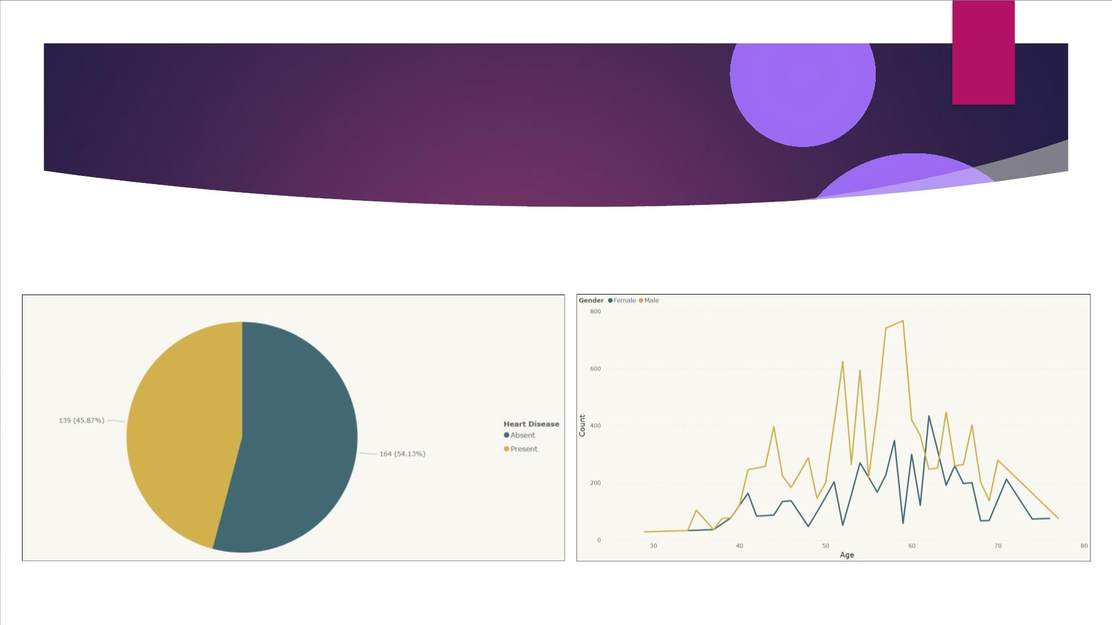
INSIGHTS
What Kind of Population do we have?
➢ 45.87% People suffering from heart disease.
➢ More men are from age category >50 and
females are from category >55

Slide 9
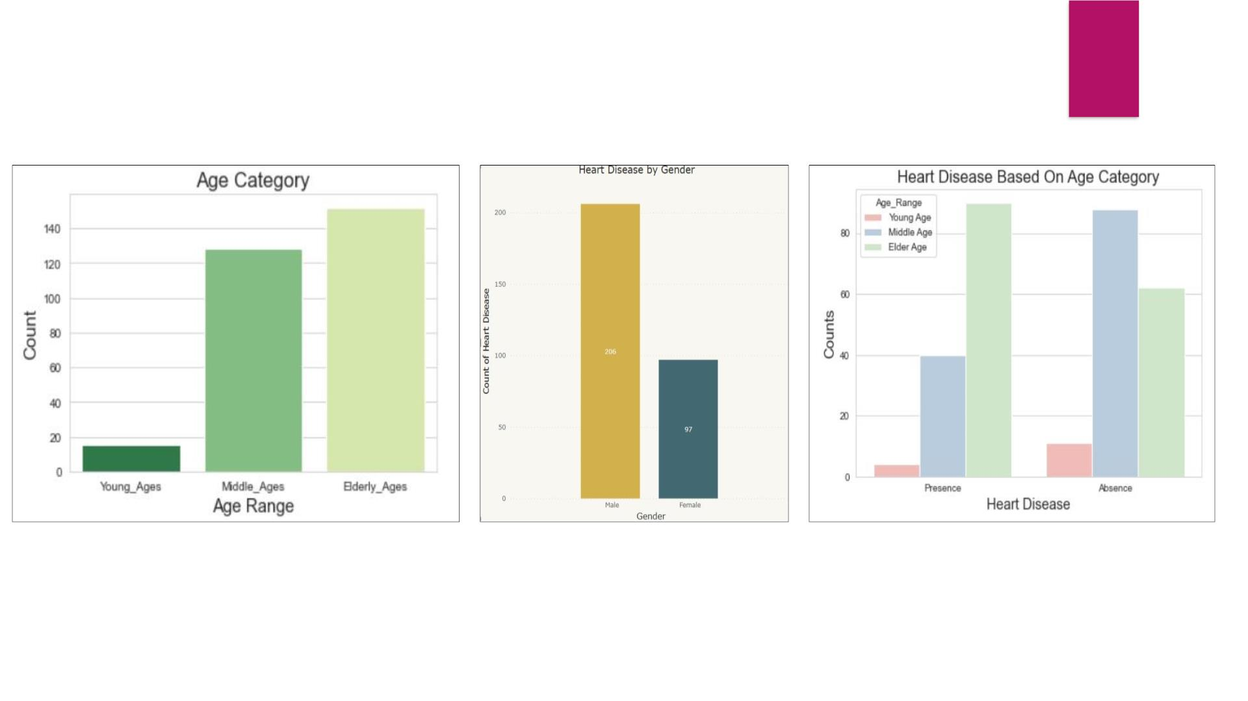
Who Suffers from Heart Disease?
➢ Elderly Aged People (>55) are
➢ Males are more prone to
➢ Elderly Aged People (>55) are
more in our population
heart disease.
more prone to heart disease.

Slide 10
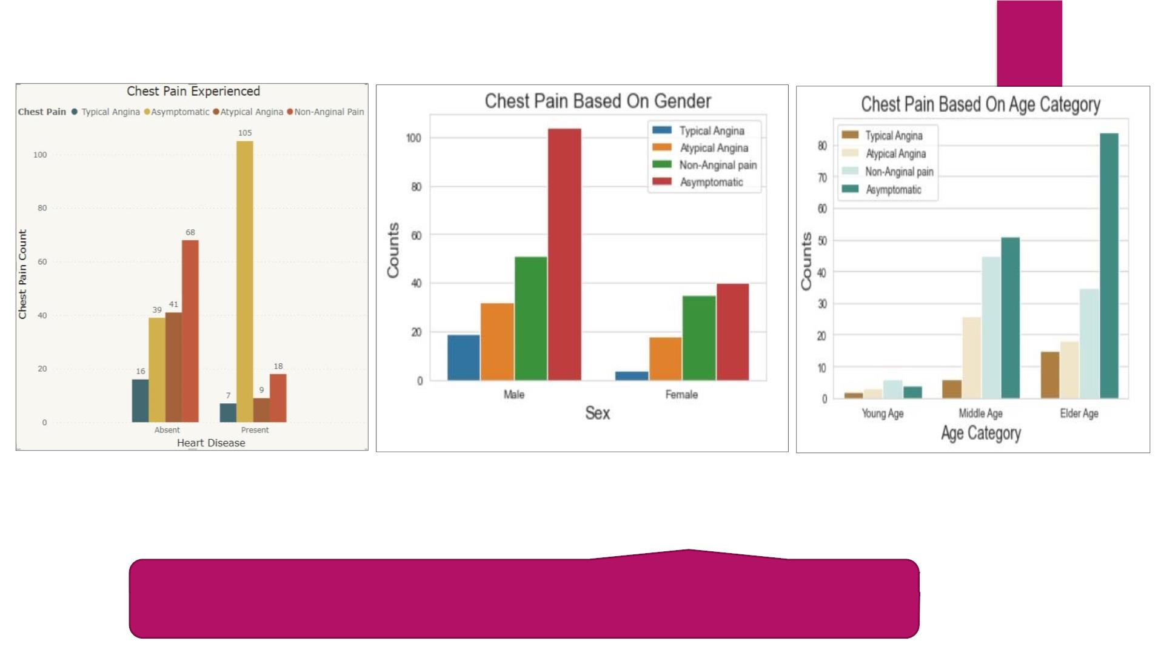
Chest Pain Experienced By Patients
➢ It seems people having
asymptomatic chest pain have
a higher chance of heart
disease.
➢ We can see that a higher number of
➢ There is very high number of
Asymptomatic Pain in Elderly
age Category
men are suffering from
Asymptomatic type of Chest Pain
Asymptomatic Chest pain means neither causing nor
exhibiting symptoms of heart disease.

Slide 11
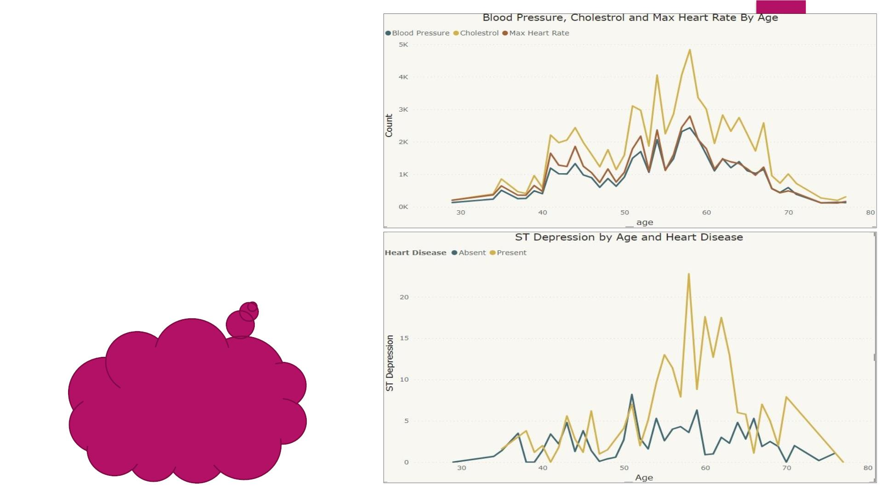
Other symptoms people
experience in heart disease
➢ Here we can observe that Blood Pressure increases
between age of 50 to 60 and somehow continue
the pattern till 70.
➢ Similarly, Cholesterol and maximum heart rate
Increasing in the age group of 50-60.
➢ we can observe from here that ST depression
mostly increases between the age group of 30-40.
ST depression refers to a
finding on an
electrocardiogram,
wherein the trace in the ST
segment is abnormally low
below the baseline.

Slide 12
KEY PERFORMANCE INDICATOR (KPI)
1. Percentage of People Having Heart Disease
2. Age Distribution including Gender
3. Gender Distribution Based on Heart Disease
4. Chest Pain Experienced by People Suffering from Heart Disease
5. Blood Pressure, Cholesterol Level and Maximum Heart Rate of
People According to their Age and Heart Disease Patients.
6. ST Depression Experienced by People According to their age and
heart disease.

Slide 13
CONCLUSION
➢ 45.87% People suffering from heart disease.
➢ Elderly Aged Men are more (50 to 60 Years) and Females are more in 55 to 65 Years Category
➢ Males are more prone to heart disease.
➢ Elderly Aged People are more prone to heart disease.
➢ People having asymptomatic chest pain have a higher chance of heart disease.
➢ High number of cholesterol level in people having heart disease.
➢ Blood Pressure increases between age of 50 to 60 and somehow continue till 70.
➢ Cholesterol and maximum heart rate Increasing in the age group of 50-60.
➢ ST depression mostly increases between the age group of 30-40.

Slide 14
Q & A
Q1) What was the type of data?
Ans) The data was the combination of numerical and Categorical values.
Q2) What’s the complete flow you followed in this Project?
Ans) Refer slide 5th for better Understanding
Q3) What techniques were you using for data?
Ans) -Removing unwanted attributes
-Visualizing relation of independent variables with each other and output variables
-Removing outliers
-Cleaning data and imputing if null values are present.
-Converting Numerical data into Categorical values.
Q 4) What were the libraries that you used in Python?
Ans) I used Pandas, NumPy and Matplotlib and Seaborn libraries in Pandas.

Slide 15

THANK YOU

